Slide 1
Summer Internship Program LoRaWAN Temperature Sensors for the City of Melville
February 2018
Notes:
Hi my name is Jack Downes.
And I’ve developed a tool to effectively capture heat data for the City of Melville.
Before I go on to introduce the solution, I’d like to explain the relationship between local government and mapping heat.

Slide 2
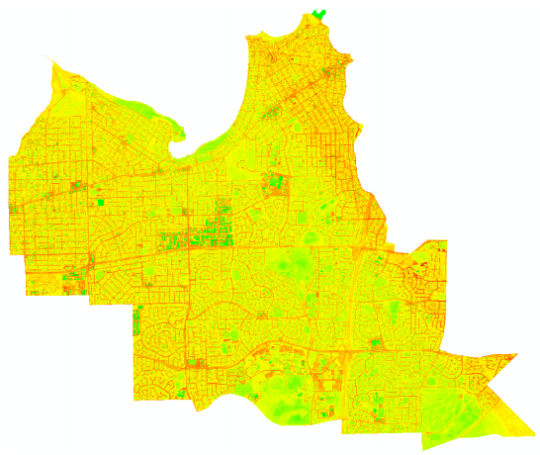
Heat Islands & Urban Forests
(Dave Schupp)
Notes:
The City of Melville are tasked with balancing the affects of Heat Islands and Urban Forests.
Heat Islands represent metropolitan areas which are significantly warmer due to energy retained in man made materials.
This can be combatted by Urban Forests, which are areas of vegetation that can act to cool air along with a host of other benefits.
As metropolitan living becomes more dense finding the balance is a question of mitigating the affect of heat islands and fully utilizing the cooling power of urban forests.
You can see clearly in this thermal satellite image of Melville the interaction between the two environments, the higher temperature road networks shown red weaving around the lower temperature forests and parks shown in green.
However the information in this form is a broad snapshot of radiant temperature, making it difficult to make material specific design decisions.

Slide 3
Problem overview
How far apart should trees be planted?
What types of Asphalt dissipate heat fasted?
Can the colour of roofs in the area have an affect the amount of heat it retains?
Does a row of trees running East West become more affective than one running North South?
Notes:
Here is a non-extensive list of issues faced by Local government when making these design choices.
limited and costly thermal imagery, manual labour or simply best judgement.
For my Summer internship with ICP I’ve been looking into a way to help decision makers make evidence based choices, by supplying them with granular, time sensitive data.

Slide 4
The Requirements
Data
Flexibility
Cost
Notes:
To do this we arrived at a solution that:
1. Would provide Data that is more localised and accountable
2. Would Cost a fraction of the price of thermal imagery
3. Is flexible enough to scale and adapt to project requirements

Slide 5
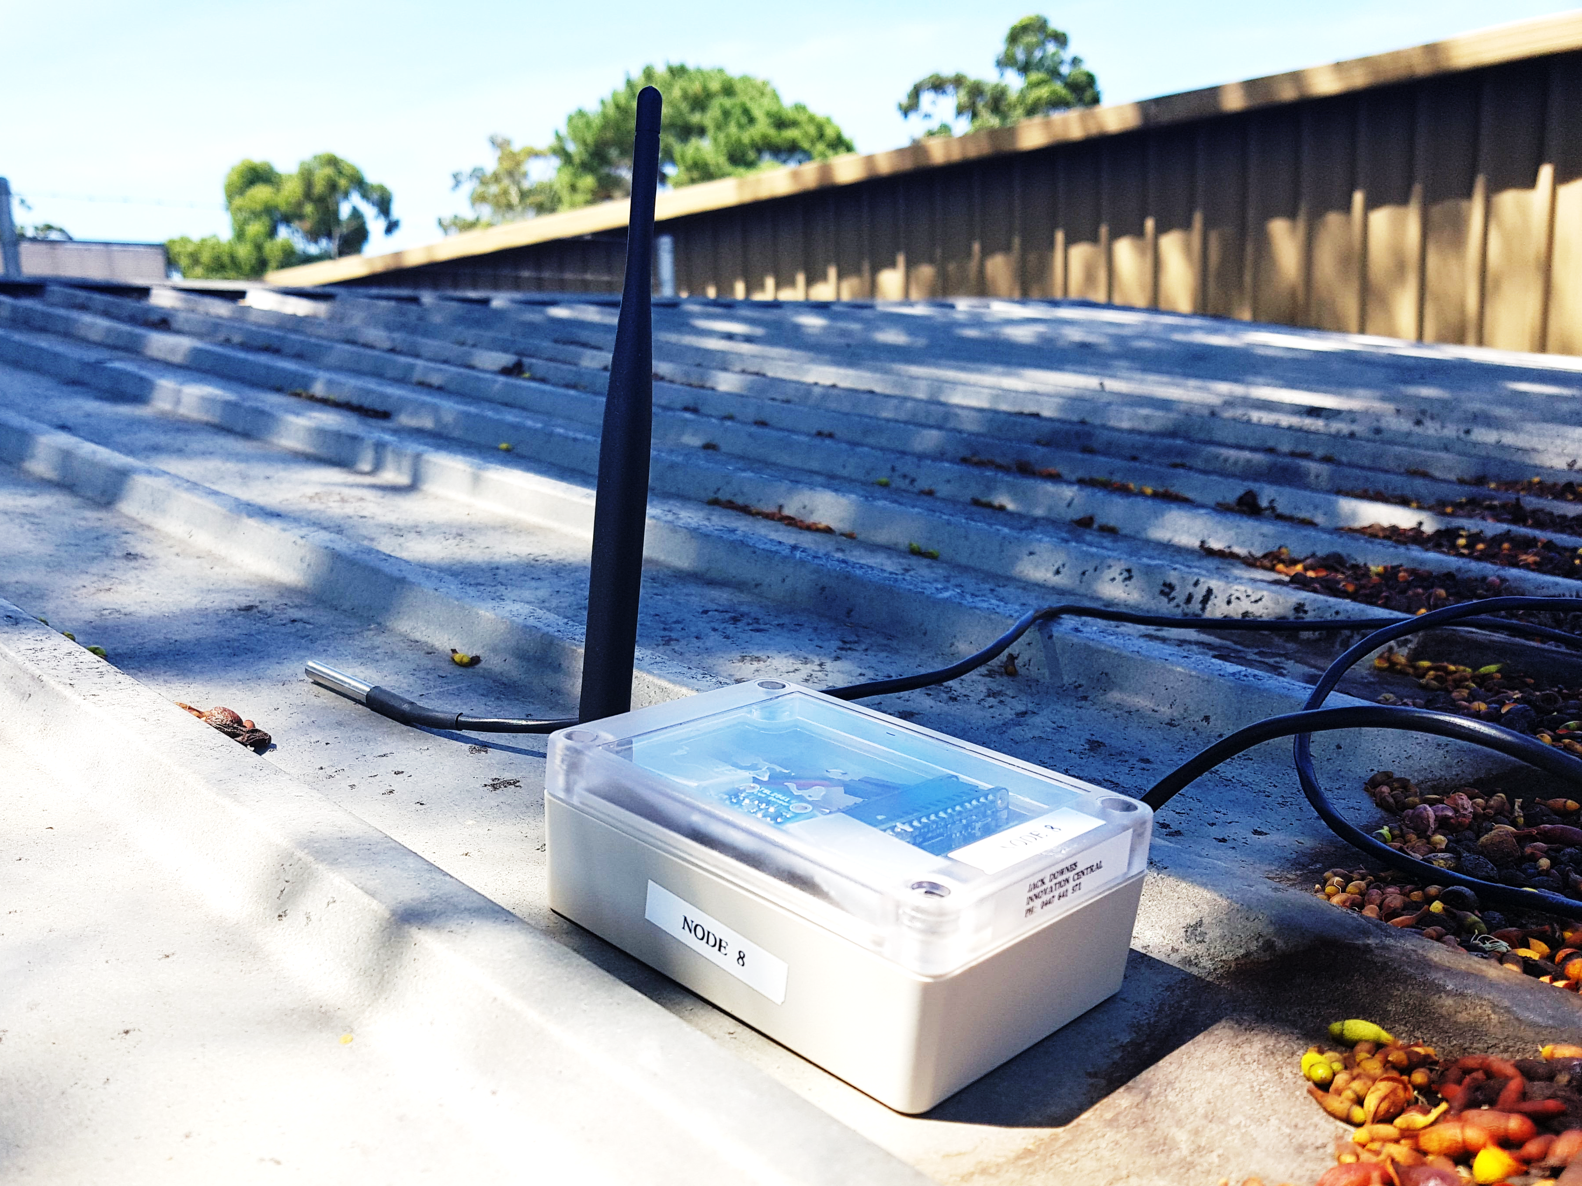
Solution
Notes:
I give you the solution. A LoRaWAN enabled battery powered sensor array.
Boasting recording intervals as regular as 60 seconds, a battery life that can endure for weeks and sharp good looks. The LoRaWAN Temperature Sensor provides an elegant solution to an array of questions.

Slide 6
The System
Sensor Array
LoRaWAN Network
Data Storage
Data visualisation
Notes:
The beauty of this solution compared to others is it’s low cost, versatility and scalability.
The unit includes a light sensor for tracking real time exposure to sun light, and an external sensor that can read the ambient air temperature.
Any amount of low power sensors can be added to the system to record things like moisture levels, humidity and even location (for those sensors that disappear).
For this project I’ve built 3 sensors that can be deployed independently, but any number can be added to the same gateway, all their data being stored in the same location and pulled together to be visualised in what ever manner makes the most sense.

Slide 7
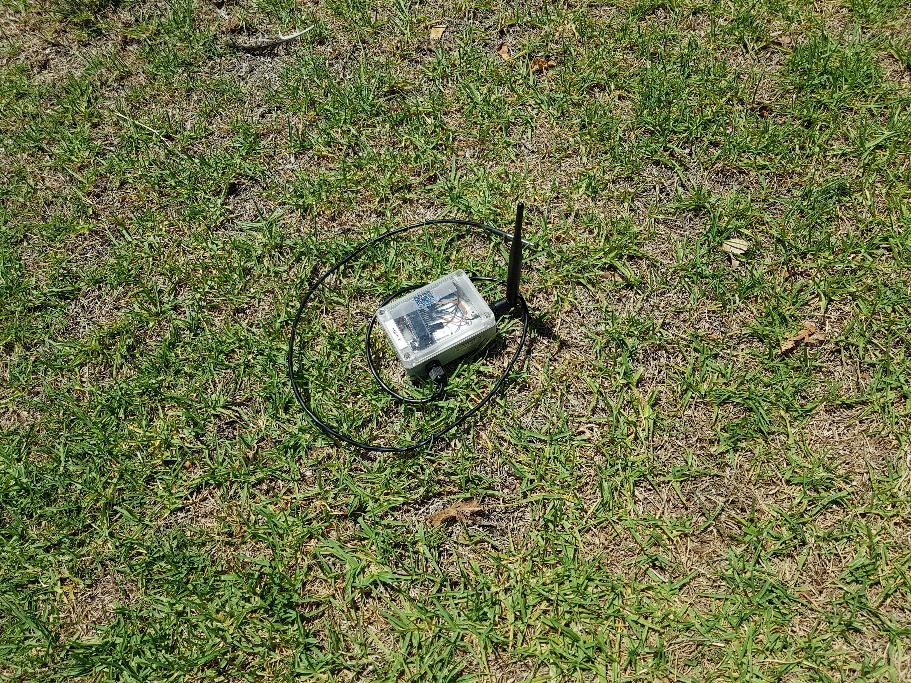
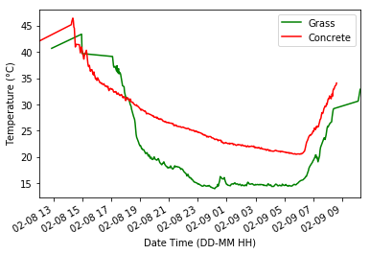
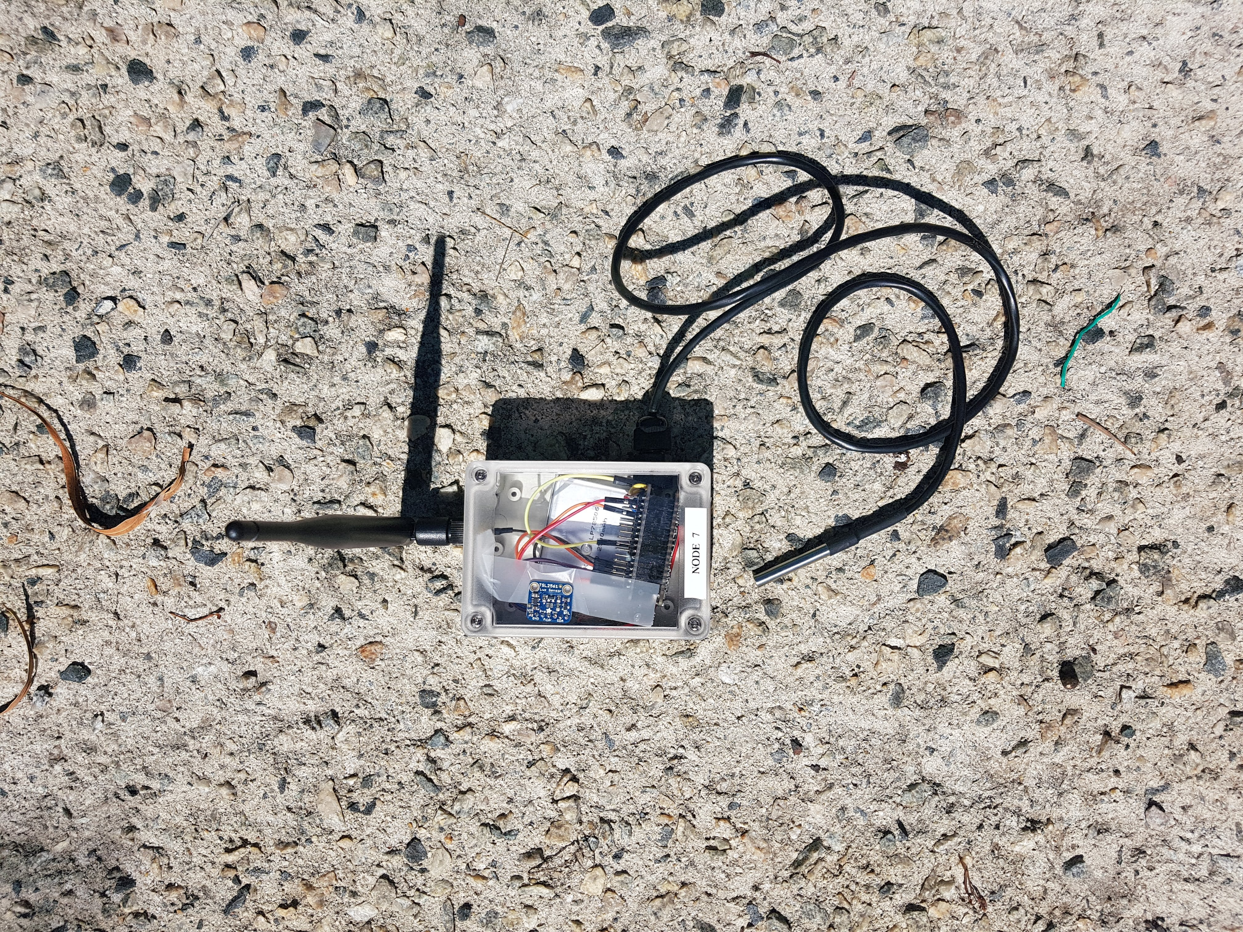
Overnight Heat Dissipation
Notes:
Here’s an example of how the unit can be deployed.
Two sensors were left overnight, one on a grassy field another on light coloured concrete.
Overnight the sensors fed information back to the database at two minute intervals.
Plotting this data side by side you can see the difference in how the materials handle heat dissipation despite being 200m apart.
During daylight hours concrete and grass sit at a similar temperature, but as darkness falls the grass rapidly drops to below 20 degrees while the concrete dissipates heat much slower.
From this we can intuitively understand the differences in Heat Islands and Urban Forests.

Slide 8
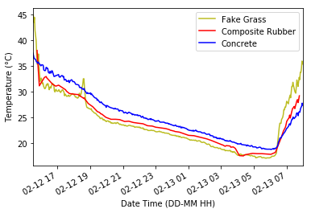
Playground Materials
Notes:
Here are 3 alternative materials that could be found in a playground. Again looking at heat dissipation over night with each plotted side by side, some interesting points stand out.
All three surfaces lose heat at a similar rate, but the rate in which they heat up in the morning begins to vary.
We can see that in this case a plastic based fake grass will reach a higher temperature than concrete by 8am in the morning.
This more direct insight into material properties can help identify trouble materials and better enable people to plan for cooler choices.

Slide 9
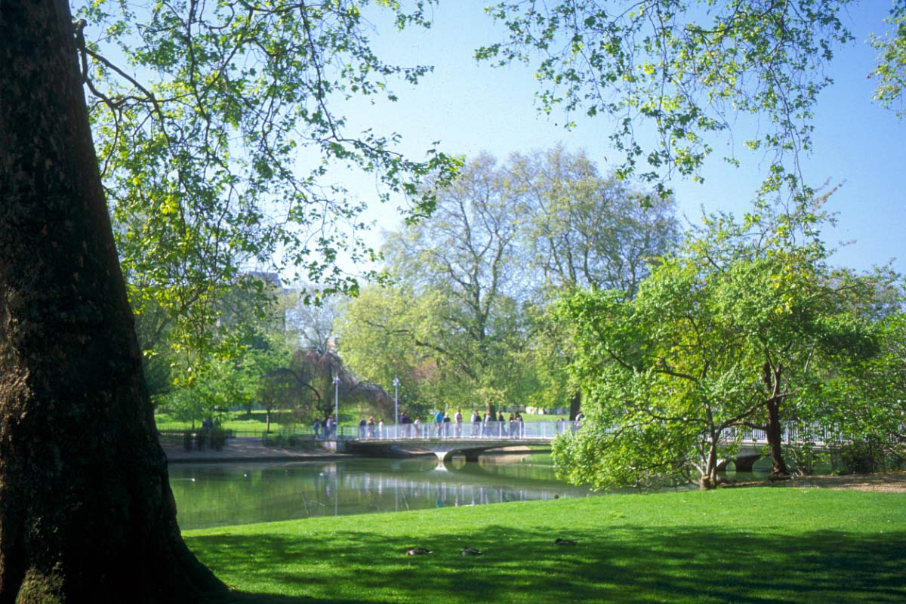
In Conclusion
This Photo by Unknown Author is licensed under CC BY-NC-ND
Notes:
In conclusion
I see this technology as a viable tool to studies into local climate control for the City of Melville.
With a growing public interest in our climate, I hope a sensor network of this type can take the guess work out of making our urban environments a cooler more inviting place to inhabit.

Slide 10
Acknowledgements
Nathan Jombwe
Iman Kareem
Janine Ahola
David Belton
Tom De Ruijter
Kevin Glasson
Petra Helmholz
Bradley Schupp

